Slide 1
Linear Classification with Scikit-Learn
Submitted by – nafis islam (14.02.04.014)

Slide 2
Basketball Score Class Prediction Assignment 3
Data Collection :
team rating
all name, height , position , point
PPG

Slide 3
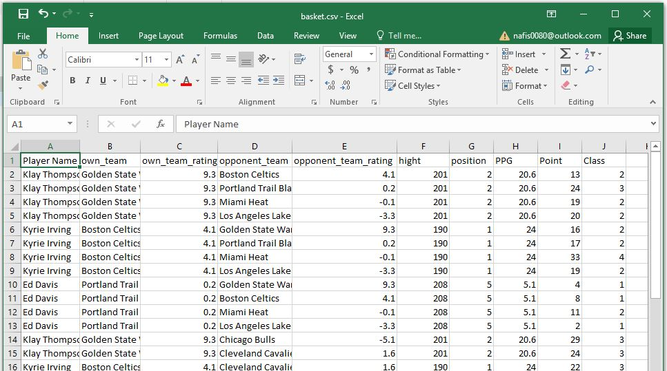
Data
Class of Score:
1 : score between 0 and 10
2 : score between 11 and 20
3 : score between 21 and 30
4 : score between 31 and 40

Slide 4
Dataset Attributes
Basket.csv
the project dataset
53 data points, with each data point having 5 features and 1 target variable
Target:
Class: the score class
Features:
Height: Player’s height.
Own team rating : Player’s own team rating.
Position : Position the player plays.
PPG : Player’s point per game average.
Opponent team rating: rating of the opponent team.

Slide 5
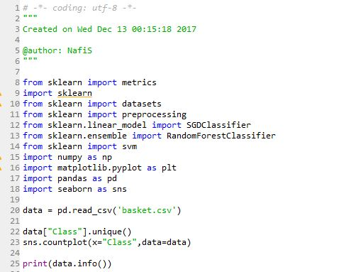
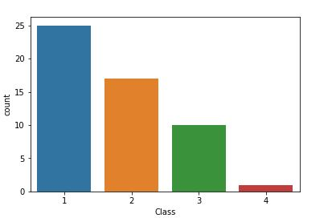
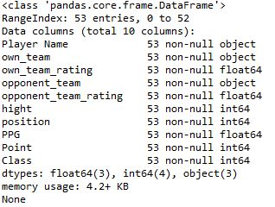
Importing the libraries and dataset

Slide 6
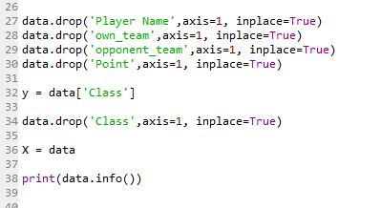
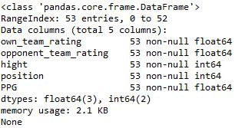
Feature Extraction

Slide 7
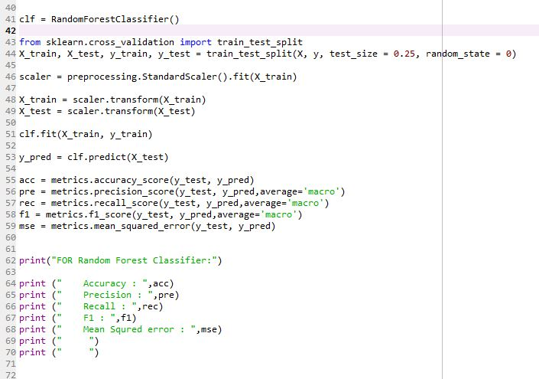
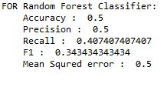
Dataset splitting and Training Using Random Forest Classifier

Slide 8
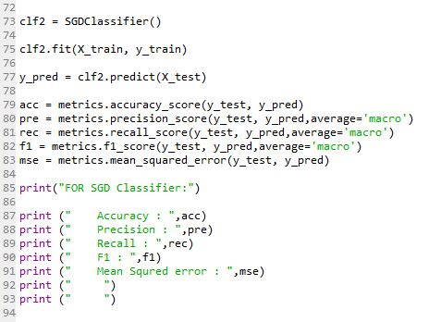
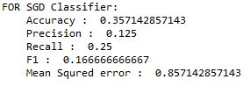
Training Using Stochastic Gradient Descent

Slide 9
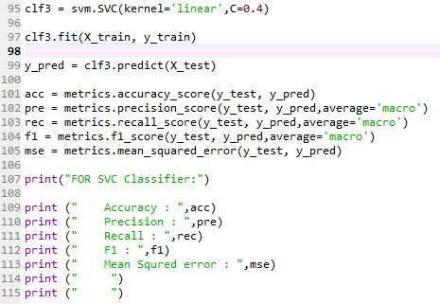
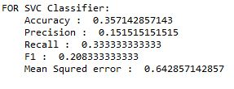
Training Using Support Vector Classification

Slide 10
Thank You

